Slide 1
Kubatov Tagaibek
ATM Java code

Slide 2
Overview
📘 Project Overview
This project is a Java-based ATM Management System developed for the command-line interface. It allows users to securely access their accounts, perform banking operations, and persist data in a JSON file. It also simulates real ATM behaviors, such as authentication, balance updates, interest on deposits or credits, and currency denomination rules.

Slide 3
⚙️ Functionality
Withdrawal Constraints
User Authentication
Balance Check & Credit Info
Timezone support

Slide 4

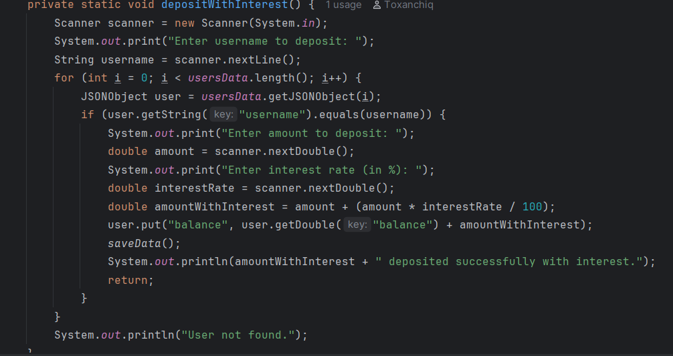
Design and Implementation
The core program is written in Java, using object-oriented programming.
All user operations are handled through functions in the main class.
File operations use Java I/O and JSON libraries to read and write user data to a file.
Proper input validation prevents incorrect formats or unsafe transactions.
Data is stored as a JSON object, making it easy to extend or analyze.

Slide 5
Challanges
As someone who wasn't attending lessons regularly, I faced many challenges during this project:
I was unfamiliar with IntelliJ IDEA, so I had to learn how to set it up from scratch.
I didn’t know how to configure Git integration and connect my project to GitHub.
At first, I accidentally committed files to a separate branch instead of the main, which caused some confusion and extra work.
Debugging file persistence and JSON handling took time, especially understanding how Java reads and writes structured data.
Despite these difficulties, I gradually learned to manage my codebase and successfully implemented all the required features.

Slide 6
This journey taught me a lot about independent learning, version control, and was really interesting to work on.

